Slide 1

Customer Shopping Behavior Analysis
Analysis of 3,900 transactions across categories to reveal spending patterns, segments, product preferences, and subscription behavior to guide strategy.

Slide 2
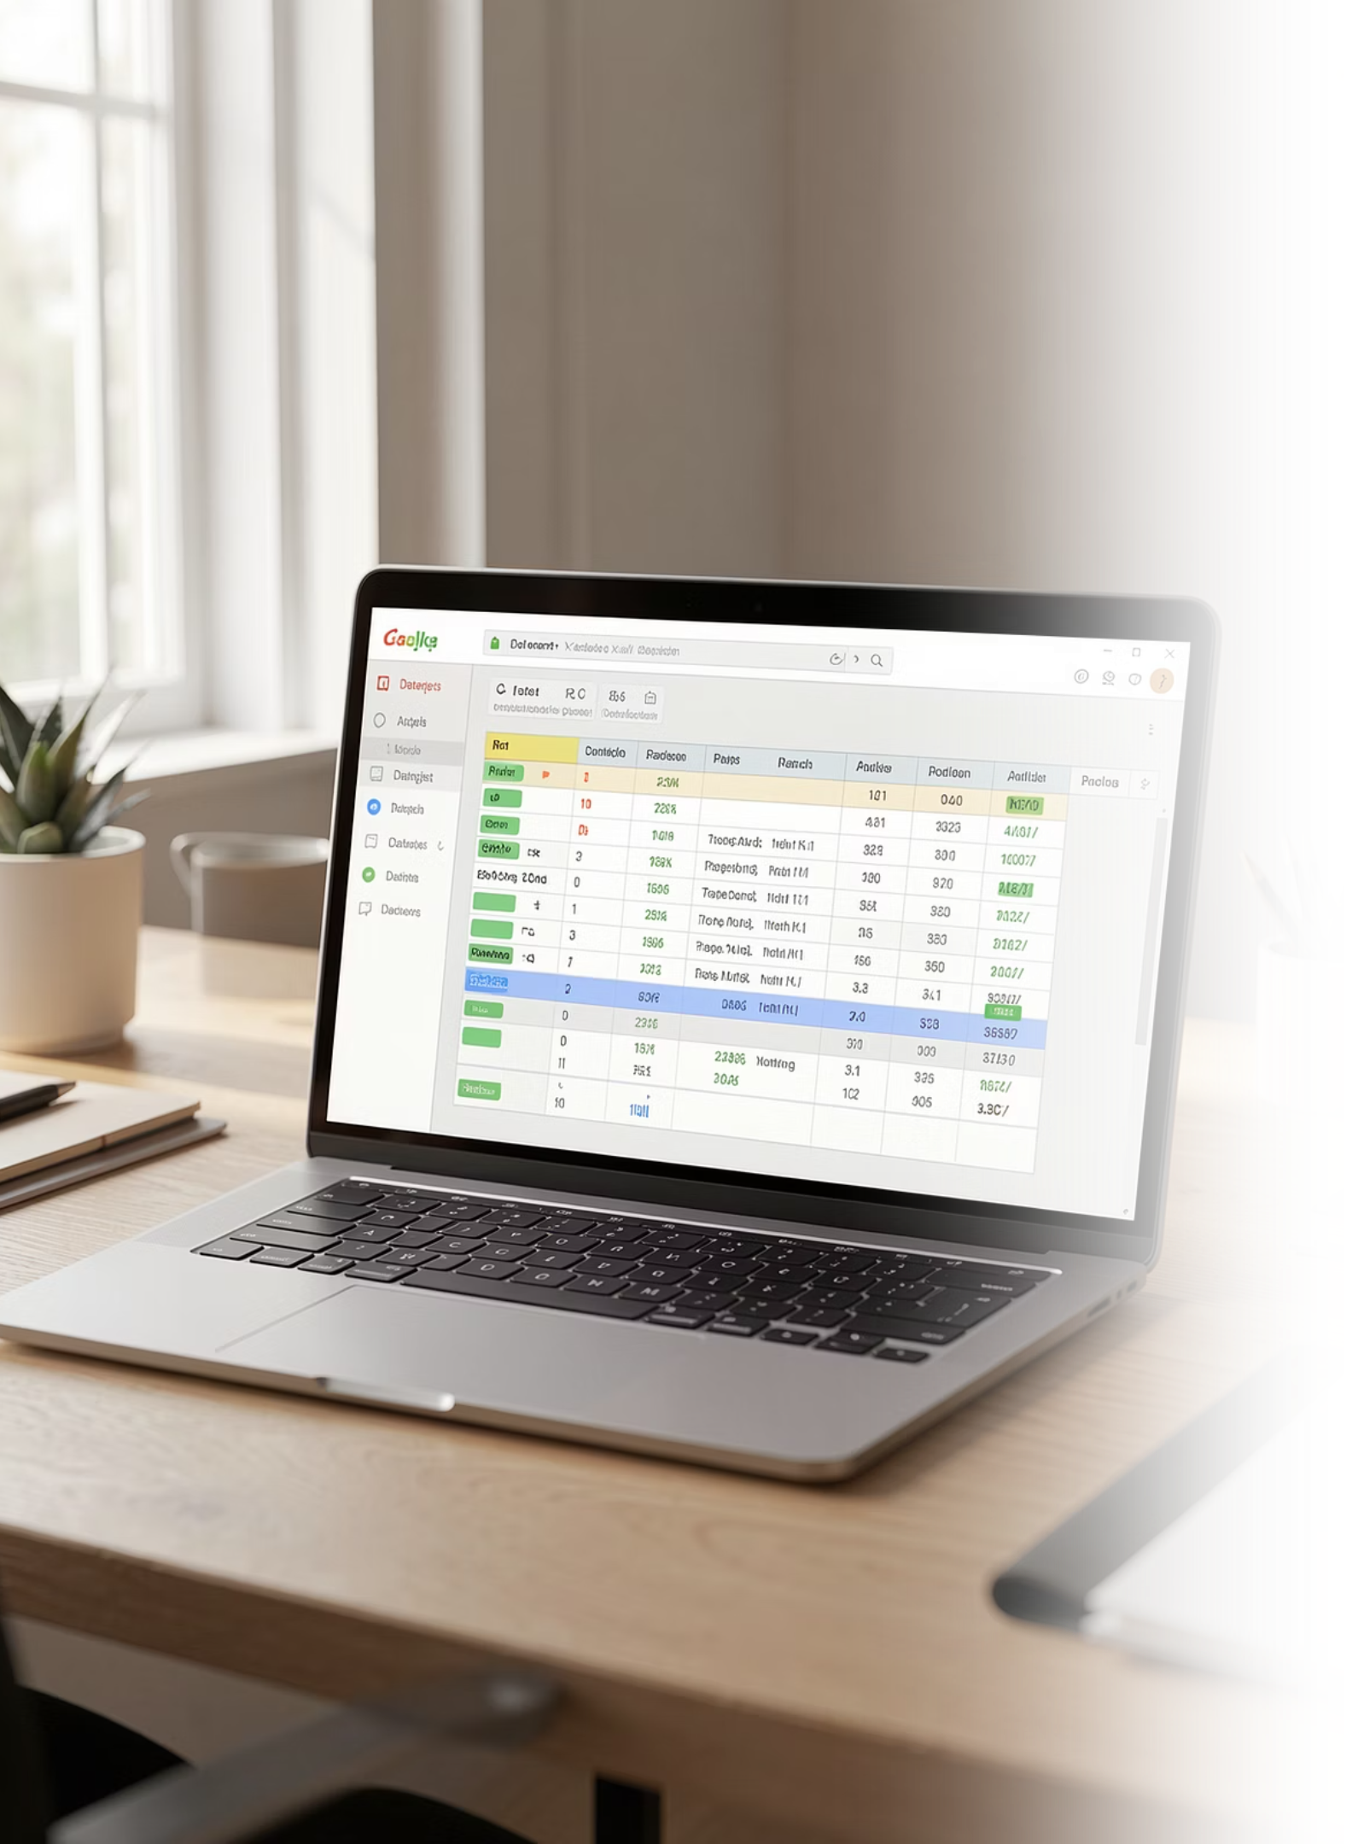
Dataset Snapshot
Size
Demographics
Purchase Details
Rows: 3,900 · Columns: 18 · Missing: 37 values in Review Rating
Age, Gender, Location, Subscription Status
Item, Category, Amount, Season, Size, Color, Shipping
Behavior
Discounts, Promo use, Frequency, Previous purchases, Ratings

Slide 3

Exploratory Data Analysis (Python)
Steps Taken
Loaded data with pandas; inspected structure with df.info() and .describe()
Summarized key statistics: mean purchase ≈ $59.76; avg rating ≈ 3.75
Identified categorical top-values (e.g., Male, Blouse, Spring)

Slide 4
Data Preparation & Feature Engineering
01
02
03
Missing Data
Standardization
New Features
Imputed Review Rating nulls using category median.
Renamed columns to snake_case for consistency.
Created age_group and purchase_frequency_days.
04
05
Consistency
Integration
Dropped promo_code_used after redundancy check with discount_applied.
Loaded cleaned DataFrame into MySQL for SQL analysis.

Slide 5
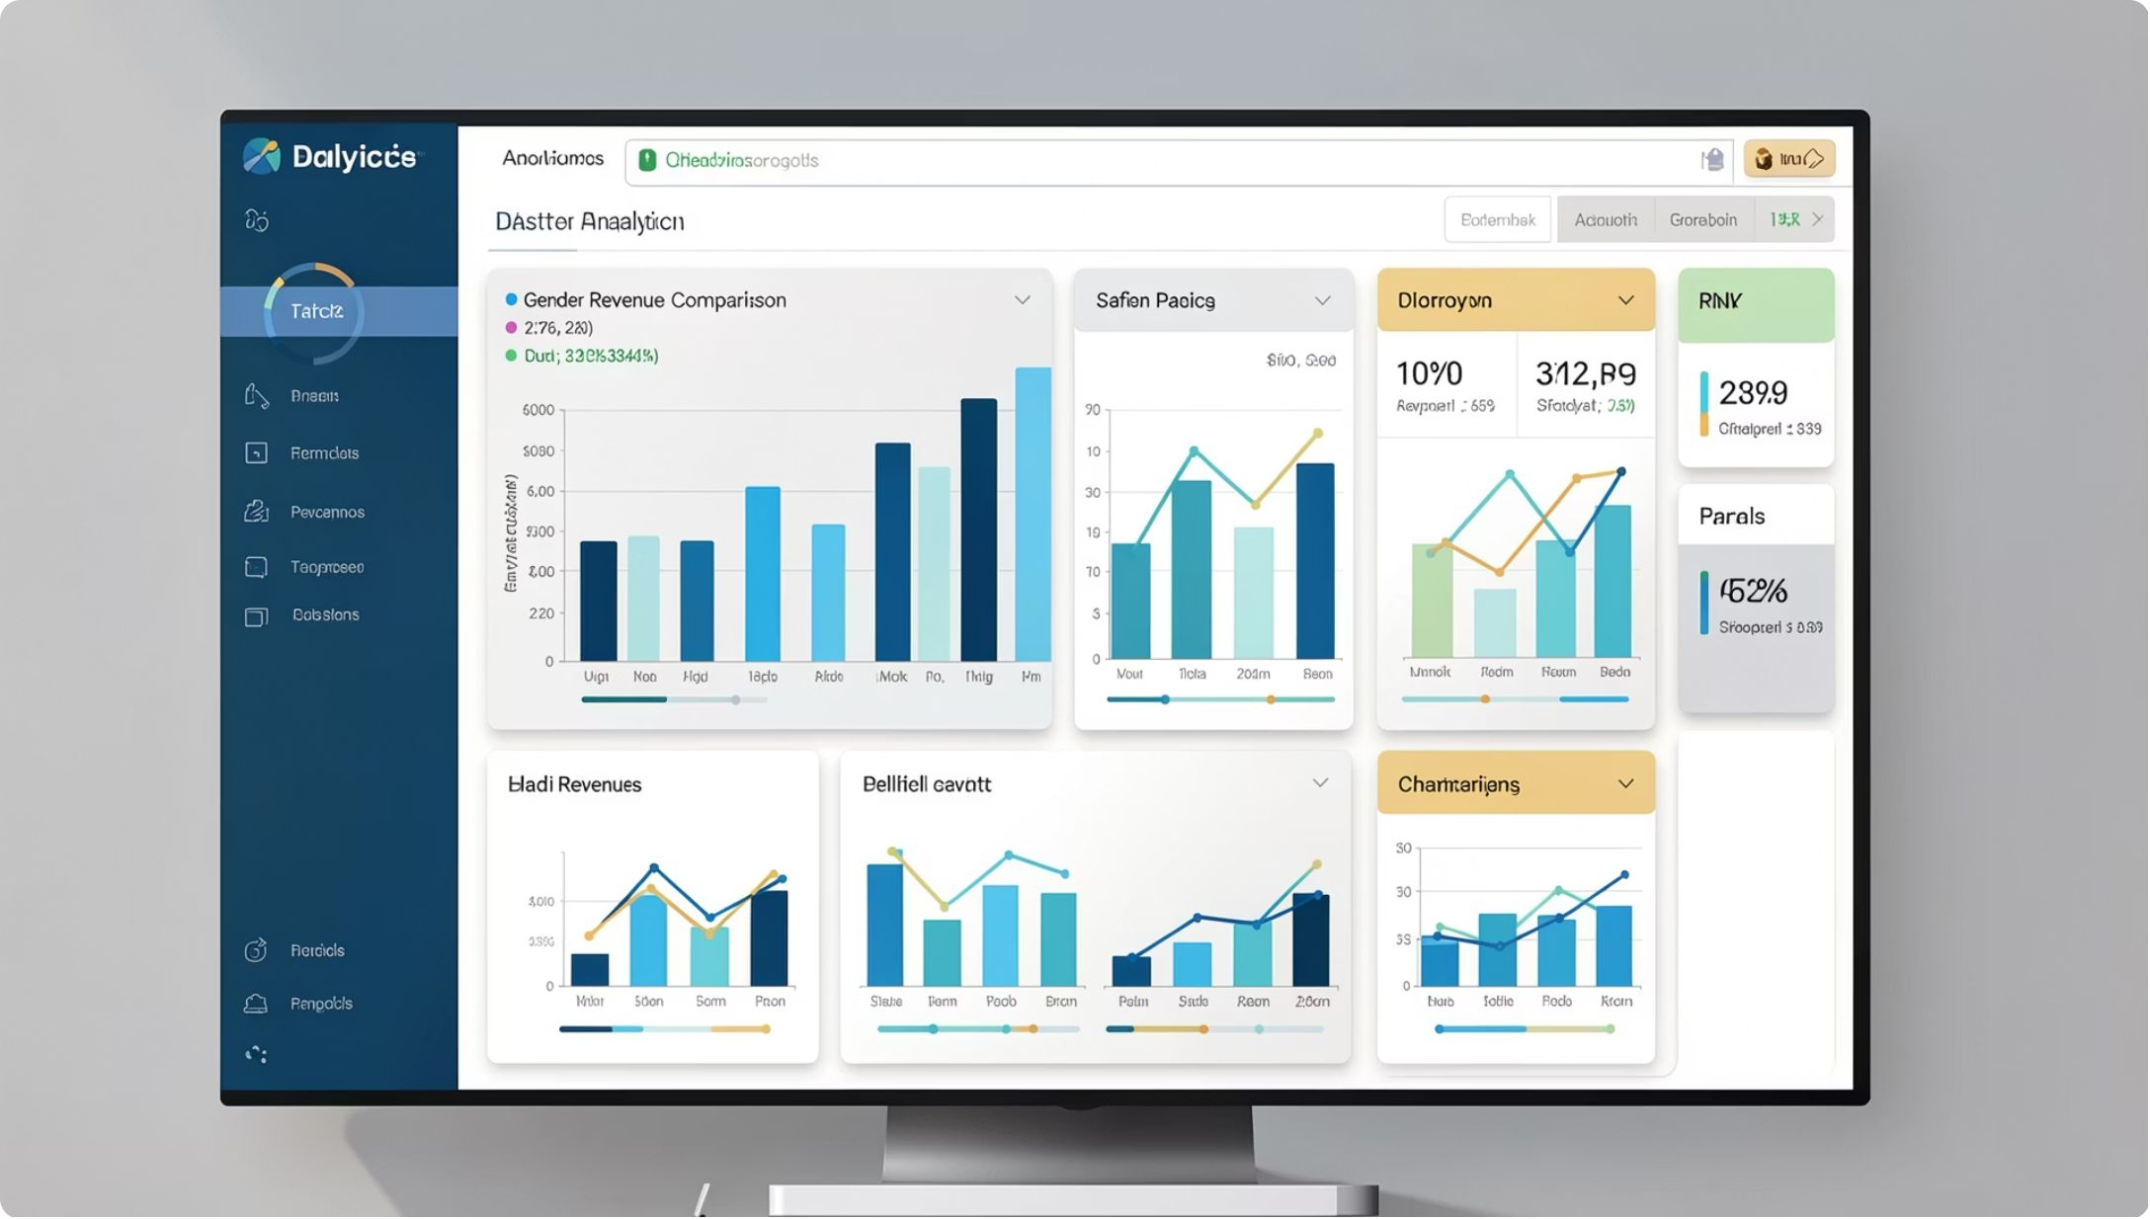
SQL Analysis — Revenue & Behavior Highlights
Revenue by Gender
Female: 75,191 · Male: 157,890
Shipping Comparison
Standard avg: $58.46 · Express avg: $60.48

Slide 6
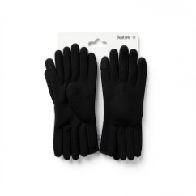
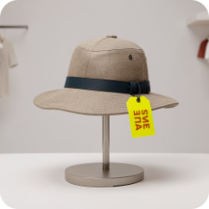

SQL Analysis — Products, Discounts & Segments
Top Rated Items
Discount-Dependent
Customer Segments
Gloves (3.86), Sandals (3.84), Boots (3.82), Hat (3.80), Skirt (3.78)
Hat 50%, Sneakers 49.66%, Coat 49.07%, Sweater 48.17%, Pants 47.37
Loyal: 3,116 · Returning: 701 · New: 83

Slide 7
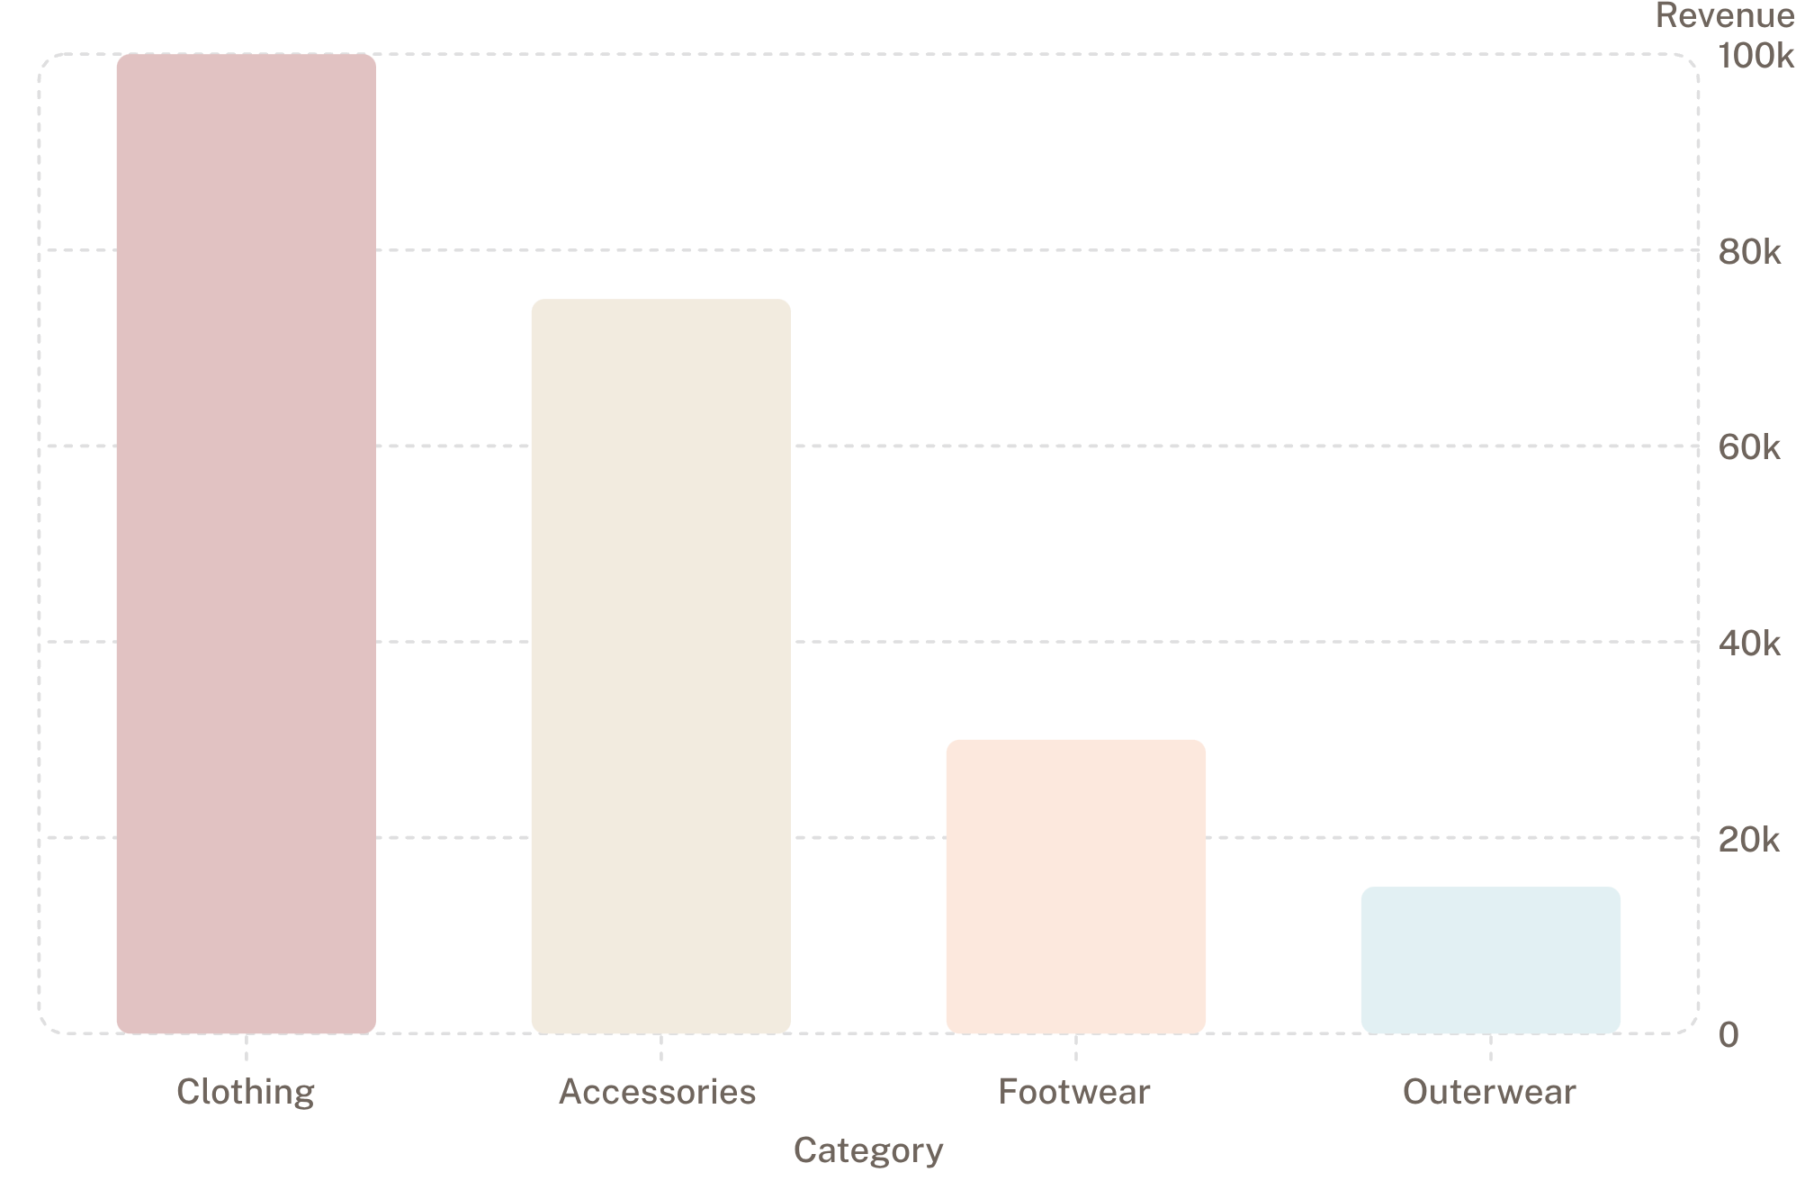
SQL Analysis — Sales & Top Products
Top Products by Category
Accessories: Jewelry, Sunglasses, Belt
Clothing: Blouse, Pants, Shirt
Footwear: Sandals, Shoes, Sneakers
Outerwear: Jacket, Coat

Slide 8
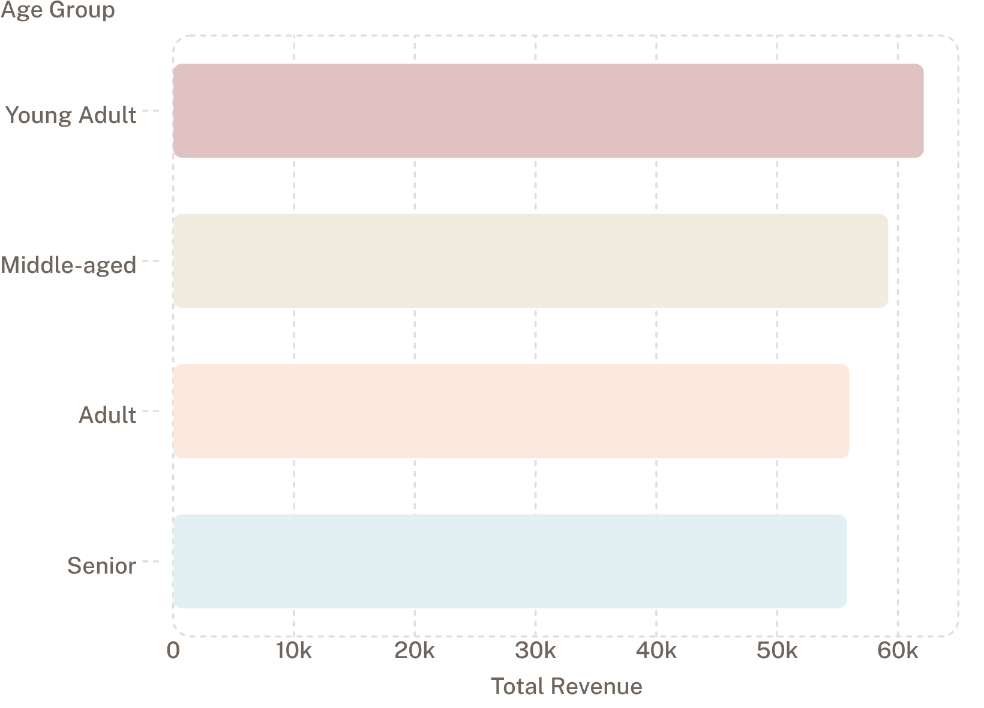
Repeat Buyers, Subscriptions & Age Revenue
Subscribers vs Non-Subscribers
Subscribers: 1,053 customers · Avg spend: $59.49 · Revenue: $62,645
Non-subscribers: 2,847 customers · Avg spend: $59.87 · Revenue: $170,436
Repeat Buyers & Subscriptions
Repeat buyers (>5 purchases): Subscribed = 958 · Not subscribed = 2,518

Slide 9
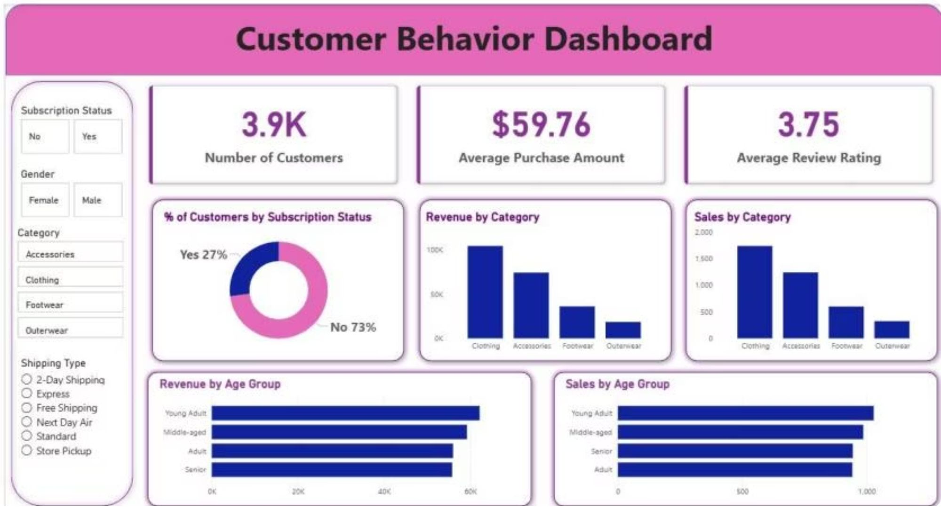
Interactive Dashboard (Power BI)
Built a Power BI dashboard to visualize metrics, filters, and age/category trends for stakeholders.
Key Metrics
Subscription Mix
Customers: 3.9K · Avg Purchase: $59.76 · Avg Rating: 3.75
Yes 27% · No 73%

Slide 10

Business Recommendations
Boost Subscriptions
Promote exclusive subscriber benefits to increase recurring revenue.
Loyalty Programs
Reward repeat buyers to grow the "Loyal" segment and retention.
Review Discount Policy
Balance promotional lifts with margin control; target discount-dependent products.
Product Positioning & Targeting
Highlight top-rated and best-selling items; focus marketing on high-revenue age groups and express-shipping users.

